Slide 1
WVBU Staff Meeting
November 2012

Slide 2
Agenda:
Board of Directors election
Training
New EAS Decoder
Advanced console operation
Transmitter
Peer Criticisms
Election Night

Slide 3
the board of directors
who can list the positions?

Slide 4
The Positions
Station Manager
Music Director (2)
Business Manager
Program Director/DJ Trainer
Promotions and Social Media Director
“Bucknell Today!” Director
Student Engineer

Slide 5
Elections will be November 25th
Sign-ups mounted in the station
No second-semester seniors

Slide 6
TRAINING!
let’s see what you know.

Slide 7
New EAS Decoder
Be able to…
Rebroadcast a message that comes in to the station
Check what alerts have recently been received

Slide 8
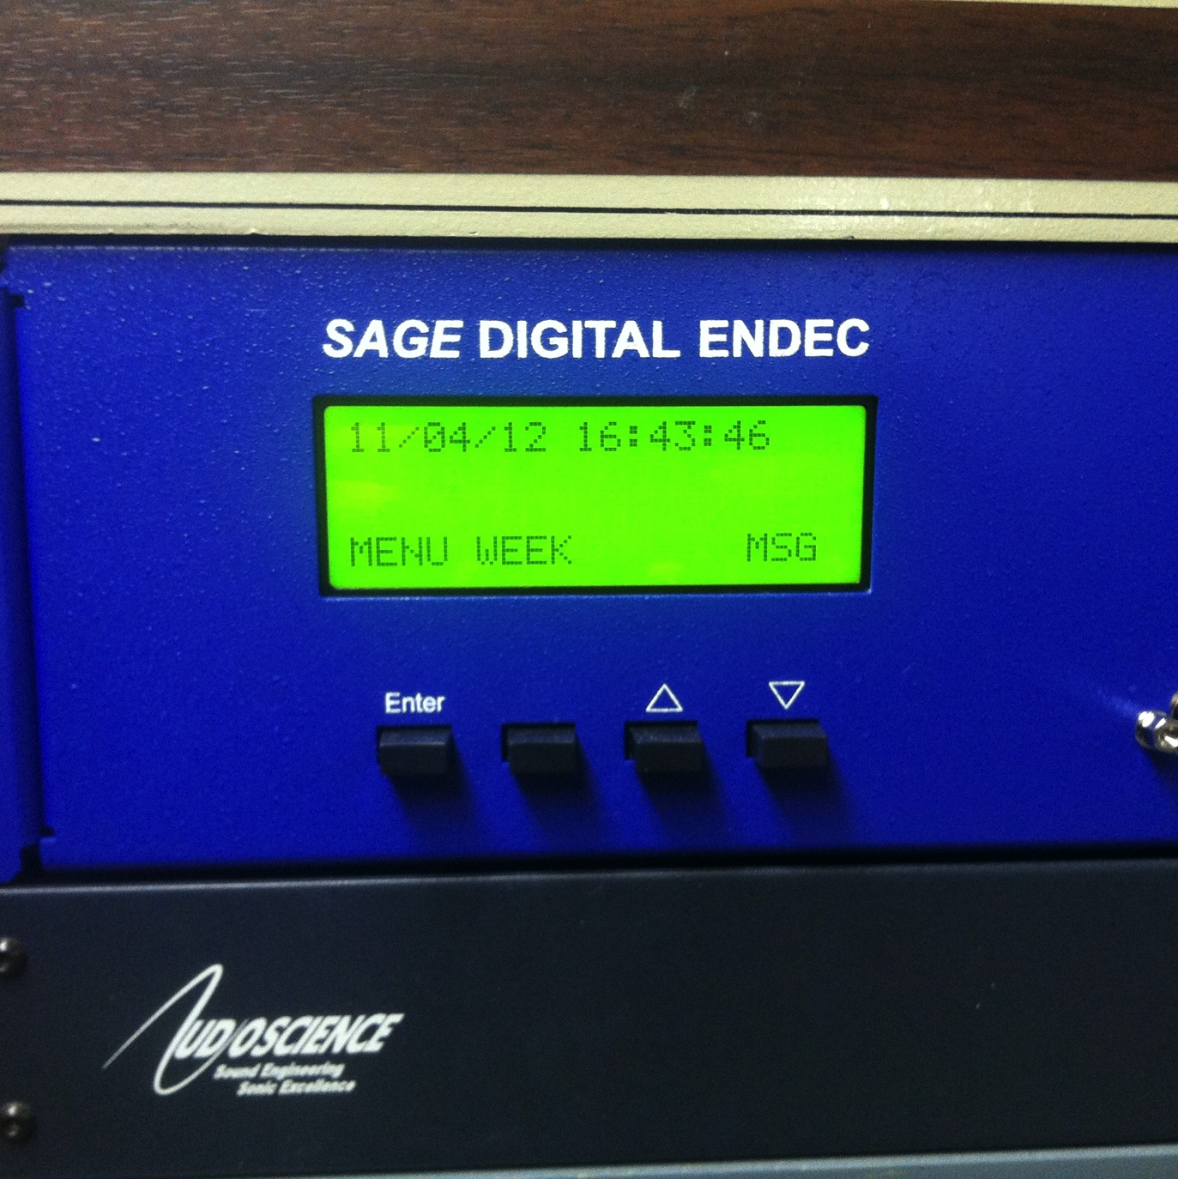
Check Recent Alerts
If an alert has come in recently and you need to see what it was, press the “MSG” button.

Slide 9
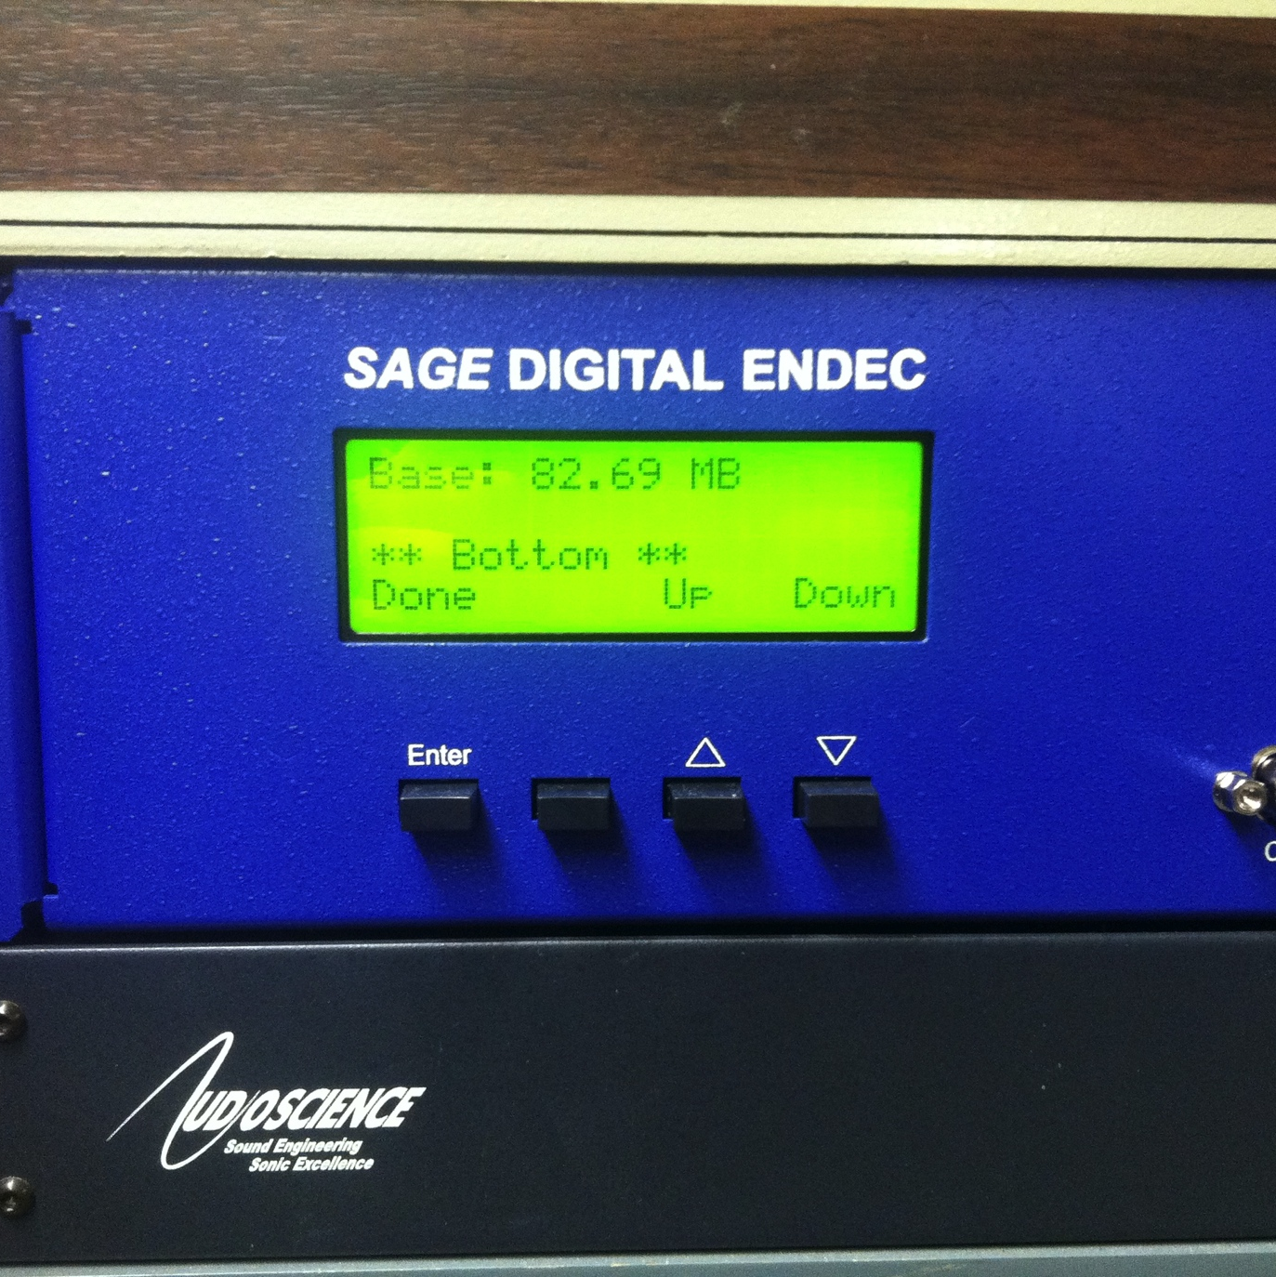
Check Recent Alerts
You will see the log of alerts sent and received, and each will tell you what was broadcast, who sent it, the times that it is active.
At the end of the log, you’ll see the
**Bottom**
Press “Done”

Slide 10
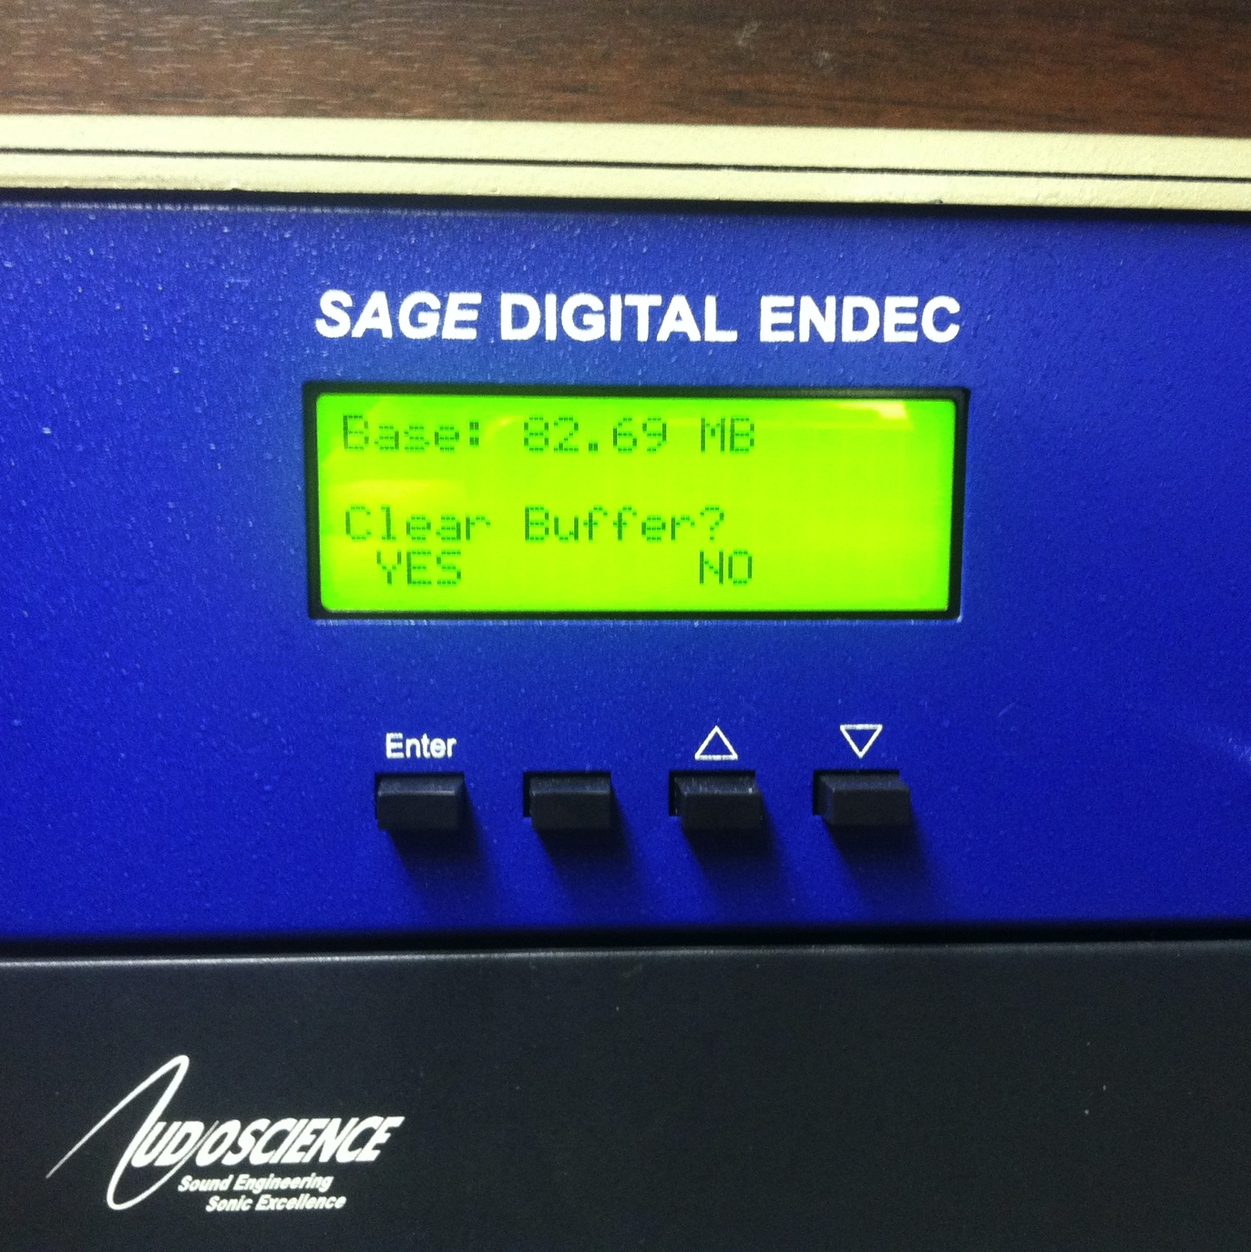
Check Recent Alerts
DO NOT CLEAR BUFFER.
This deletes the messages, and the engineer or GM will need to check these.
Sometimes, there won’t be any alerts, which means that someone has logged them recently.

Slide 11
WHEN DO I NEED TO DO THIS???
Check at the beginning of your show.
If the “MSG” button is visible, check it the messages.
If there is a “real” alert (telephone outage, storm warning, etc.), you need to announce it on the air.
If an alert ever comes in that we need to pass along, the machine will do it on its own, but it doesn’t announce things for us, just passes the message down the line.

Slide 12
the console
it’s not supposed to be scary

Slide 13
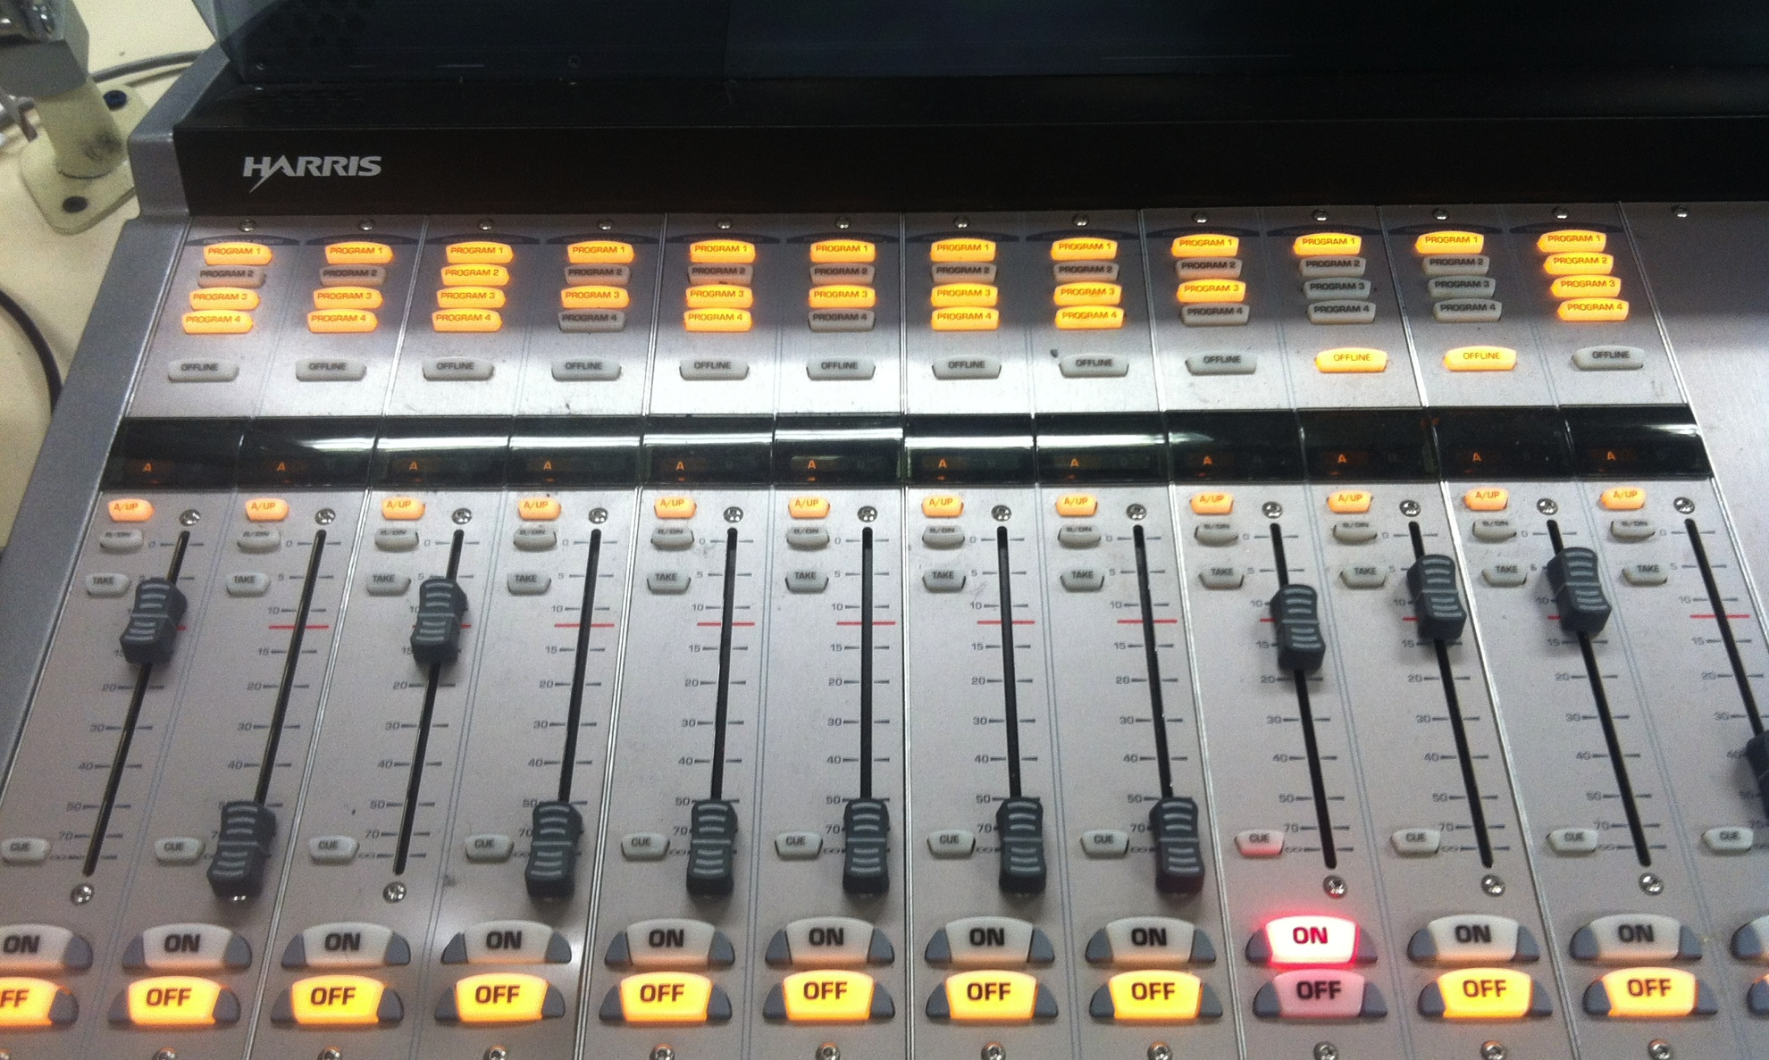
What are programs?

Slide 14
What are programs?
These help us choose where the sound in each channel is sent

Slide 15
What are programs?
If a program is bright, it’s “ON”

Slide 16
What are programs?
What do they mean? Which is which?
PROGRAM 1: Broadcast (Radio and web)
PROGRAM 2: Phone line
PROGRAM 3: VU meters
PROGRAM 4: -nothing-

Slide 17
What are programs?
SO:
If you’re on-air with a caller, but you only want to use the VU meters to see how loud mic 2 is, how should the mic channels be set?
Why is the phone channel (last one) wrong in this picture?

Slide 18
using the transmitter controls
that’s a lot of buttons!

Slide 19
peer critiques
judge your friends

Slide 20
UPCOMING: ELECTION NIGHT
be there.

Slide 21
anything else?
i missed something

